Slide 2
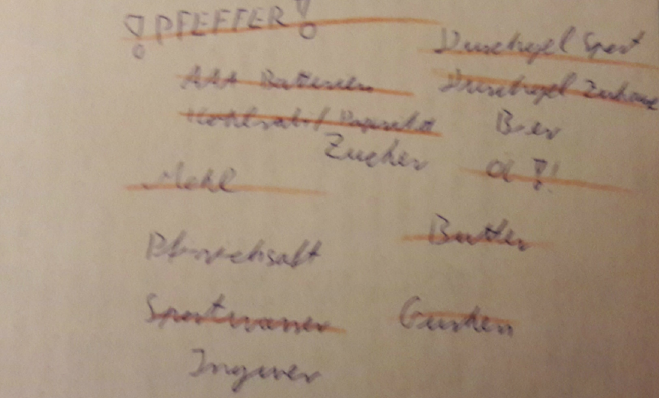

Slide 3
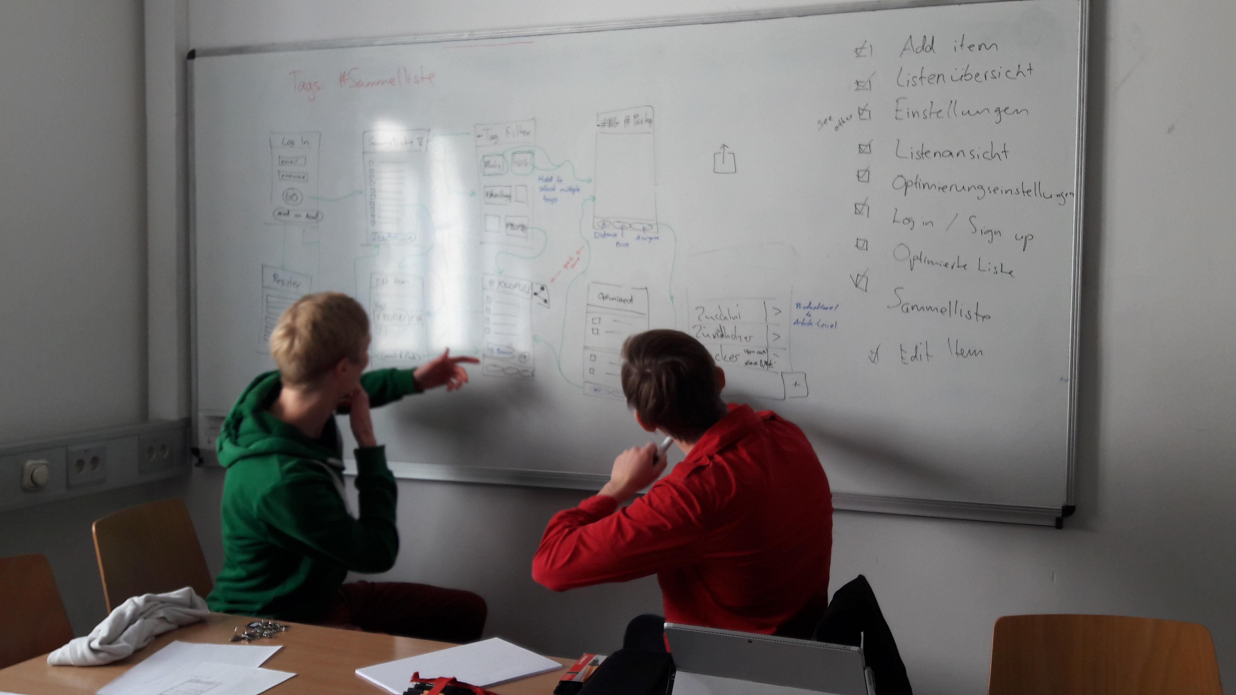
Inception

Slide 4

Literature Research

Slide 5

Design Brief

Slide 6
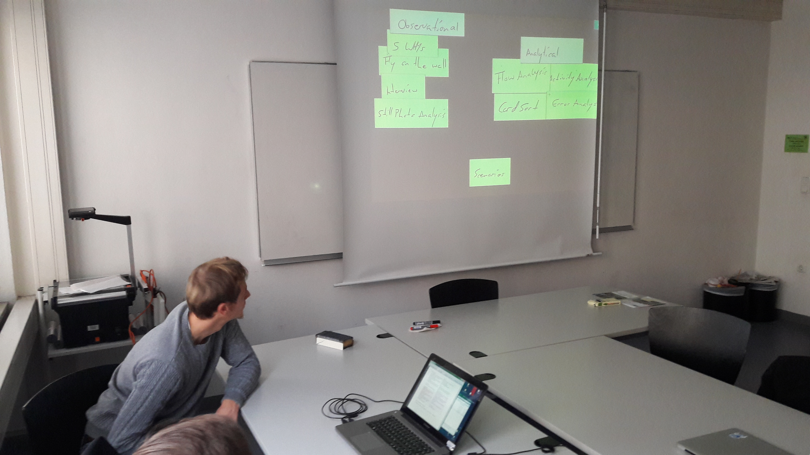
IDEO cards

Slide 7
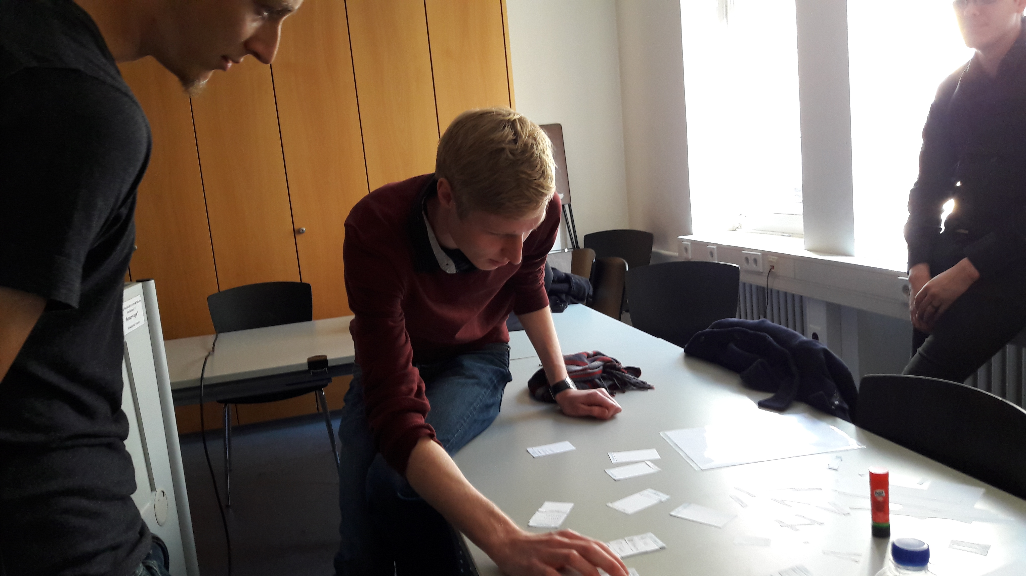
IDEO cards

Slide 8
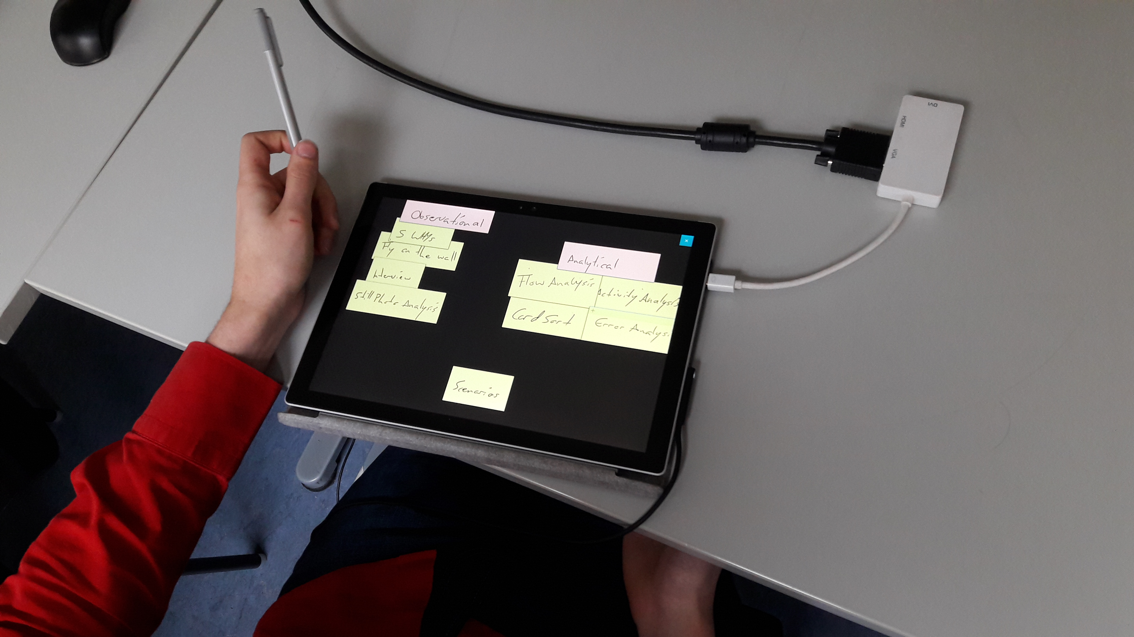
IDEO cards
Card sorting

Slide 9
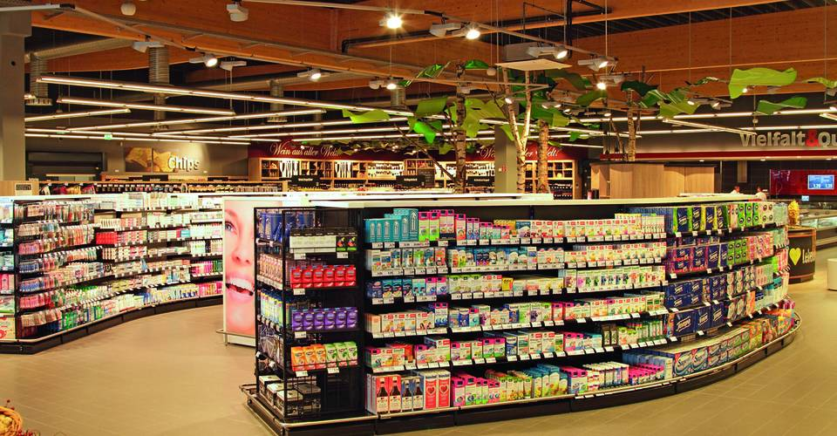
Field research

Slide 10
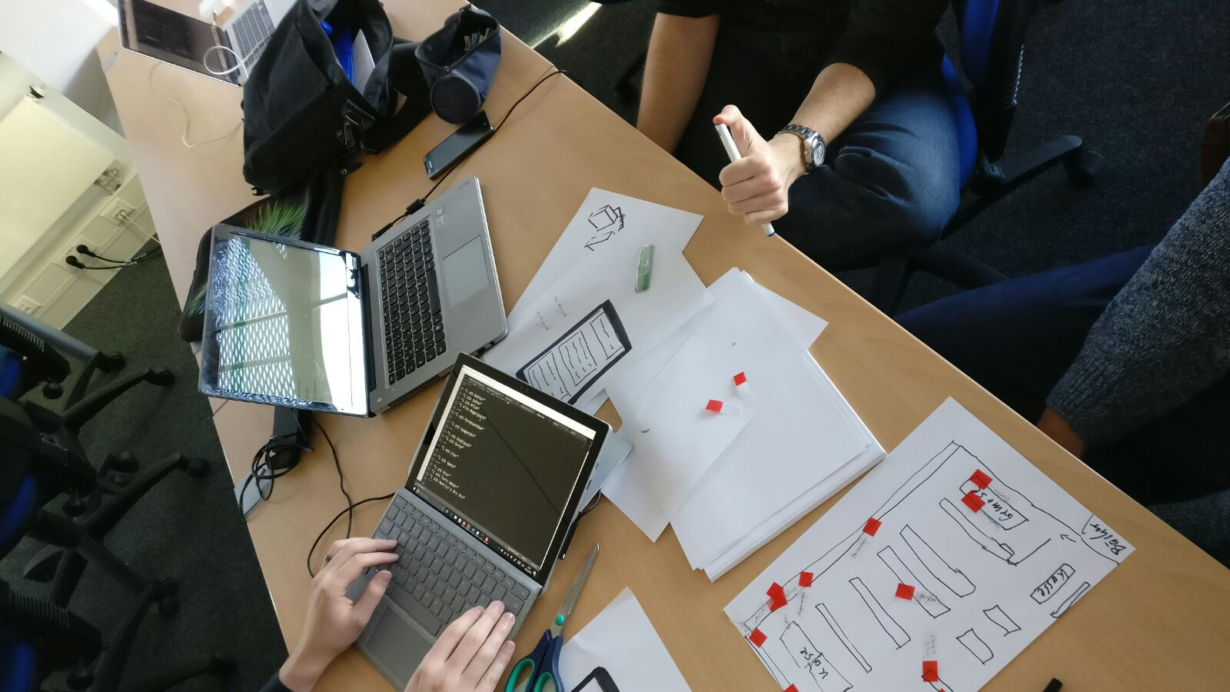
Paper Prototyping

Slide 11
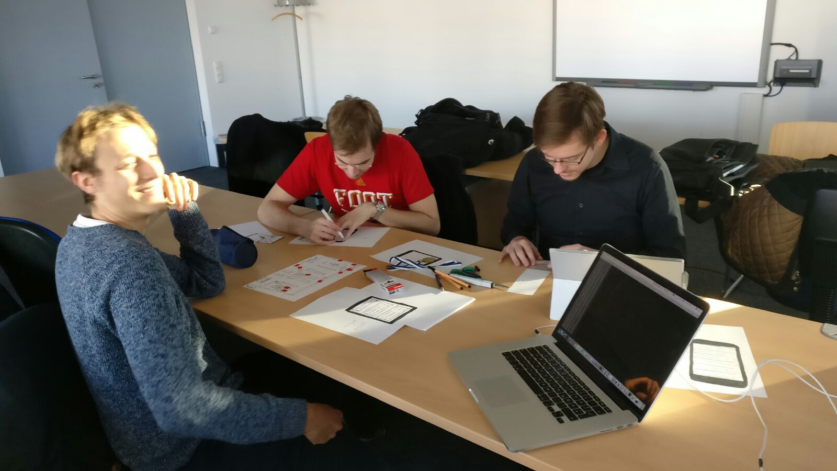
Paper Prototyping

Slide 12
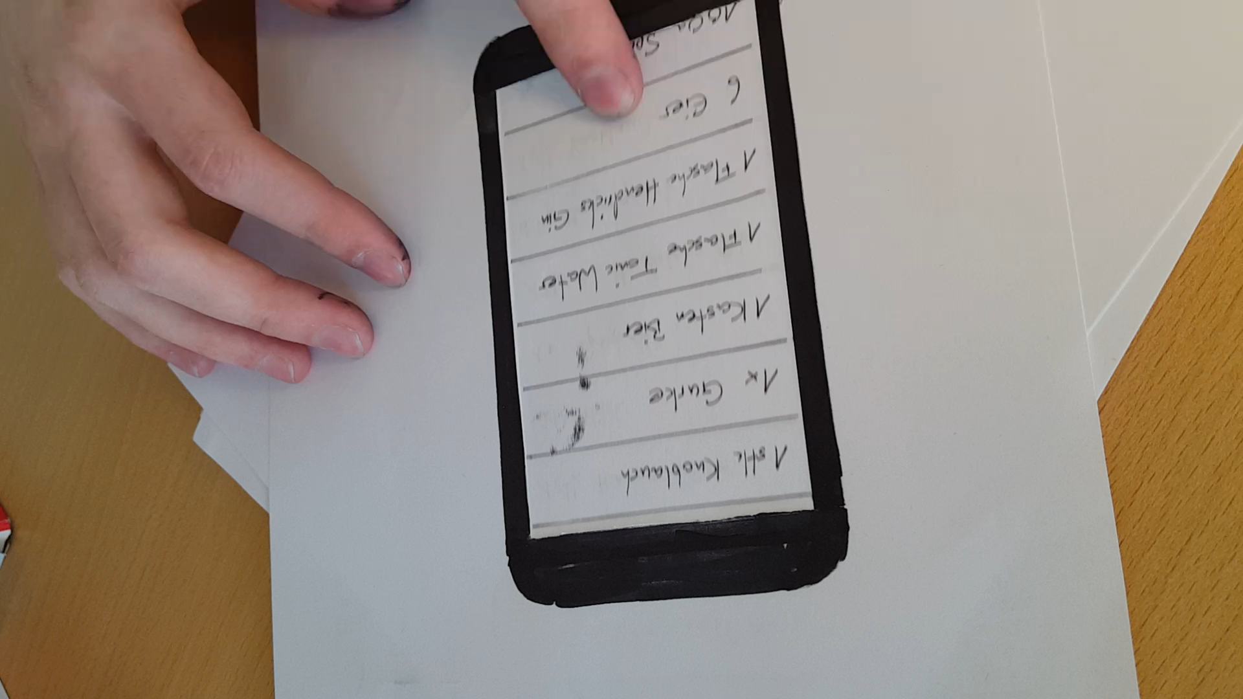

Slide 13
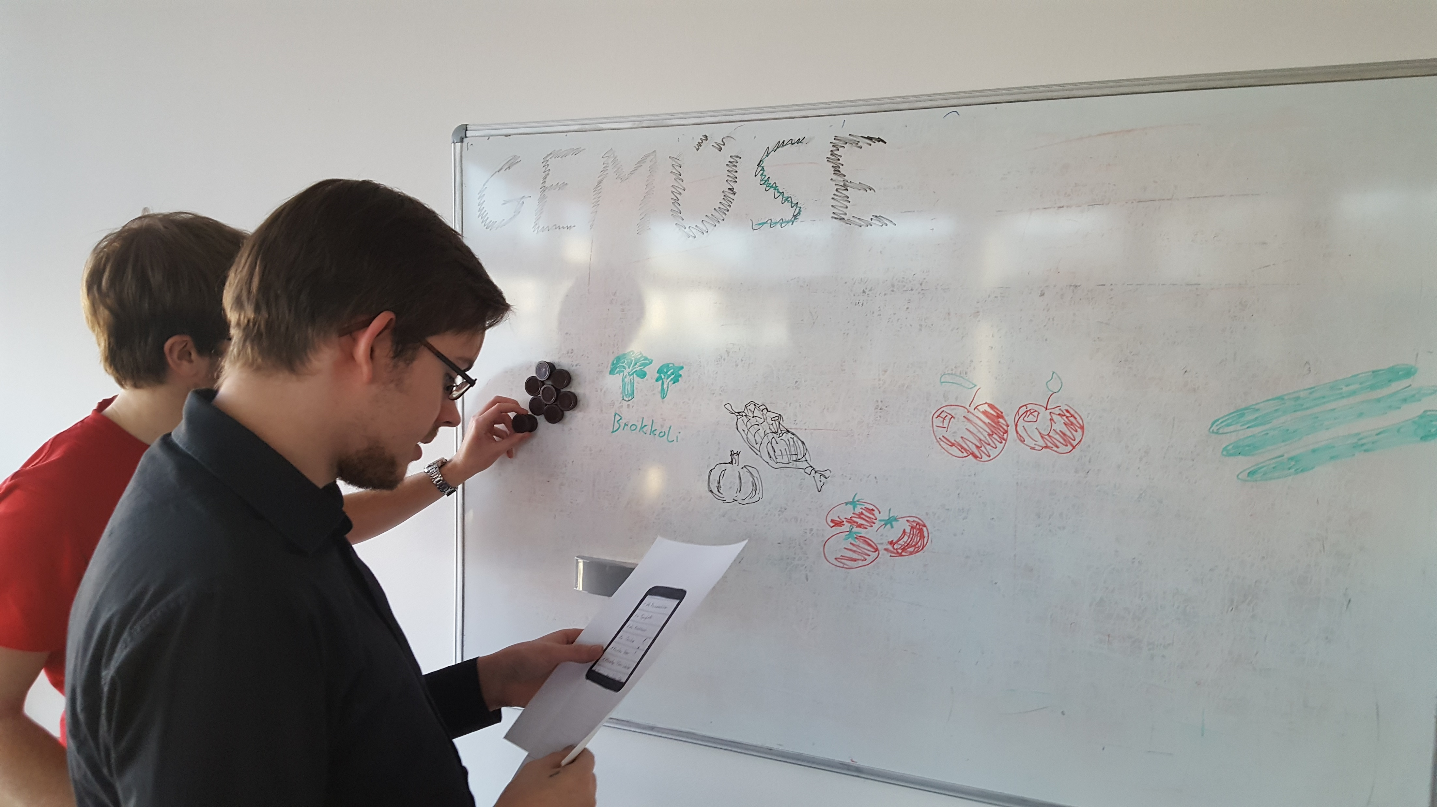
Paper Prototyping

Slide 14
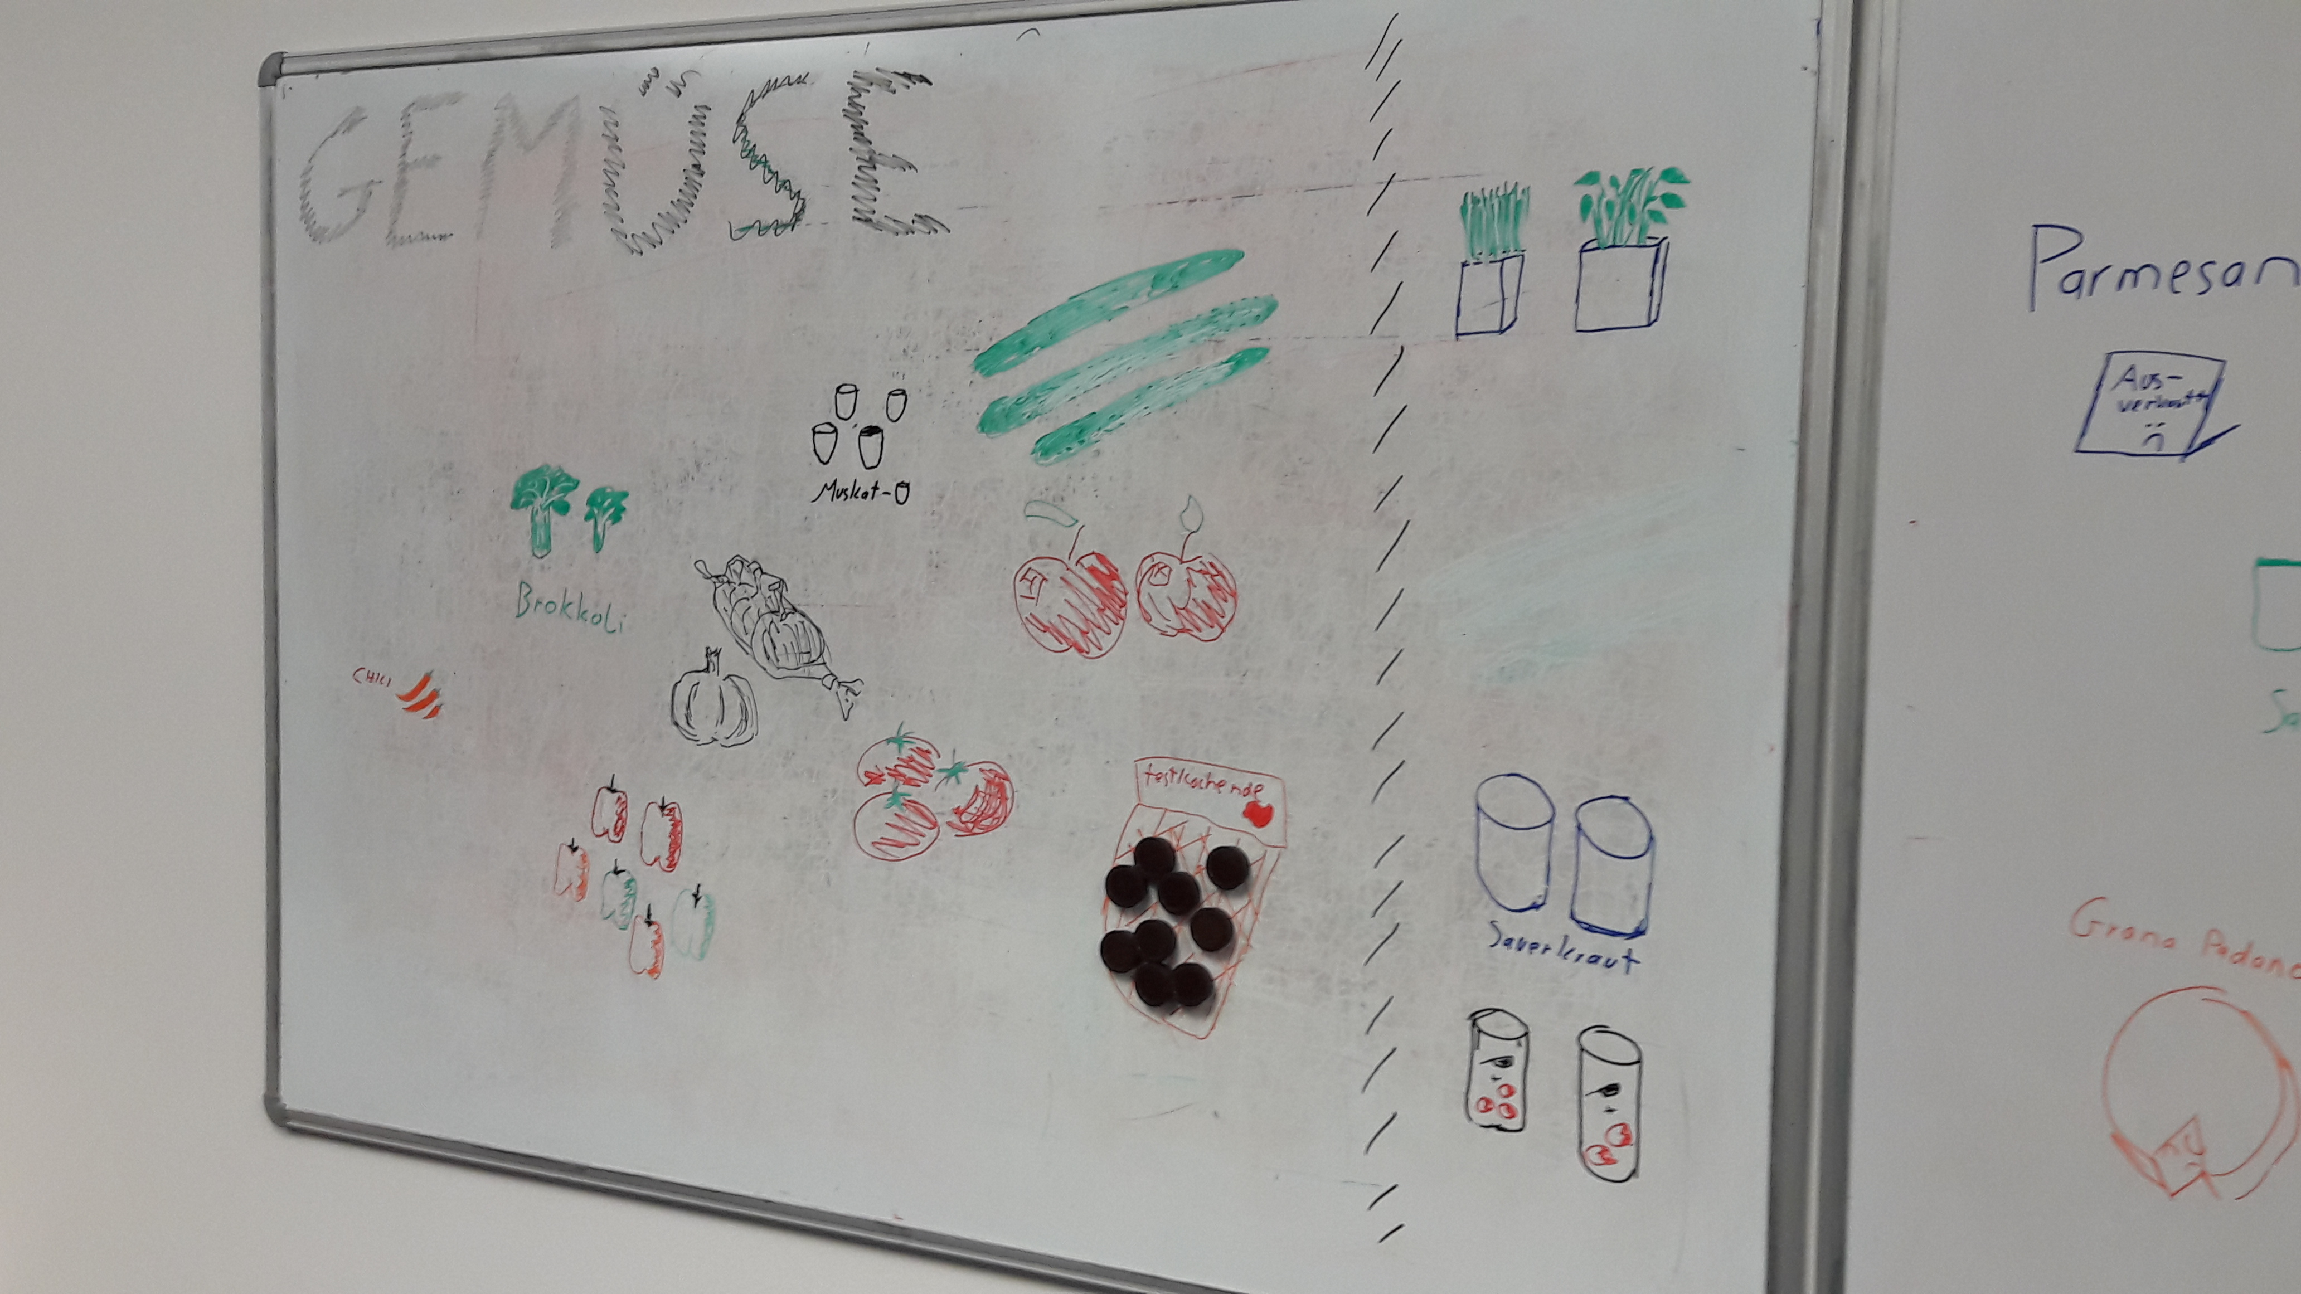
Paper Prototyping

Slide 15
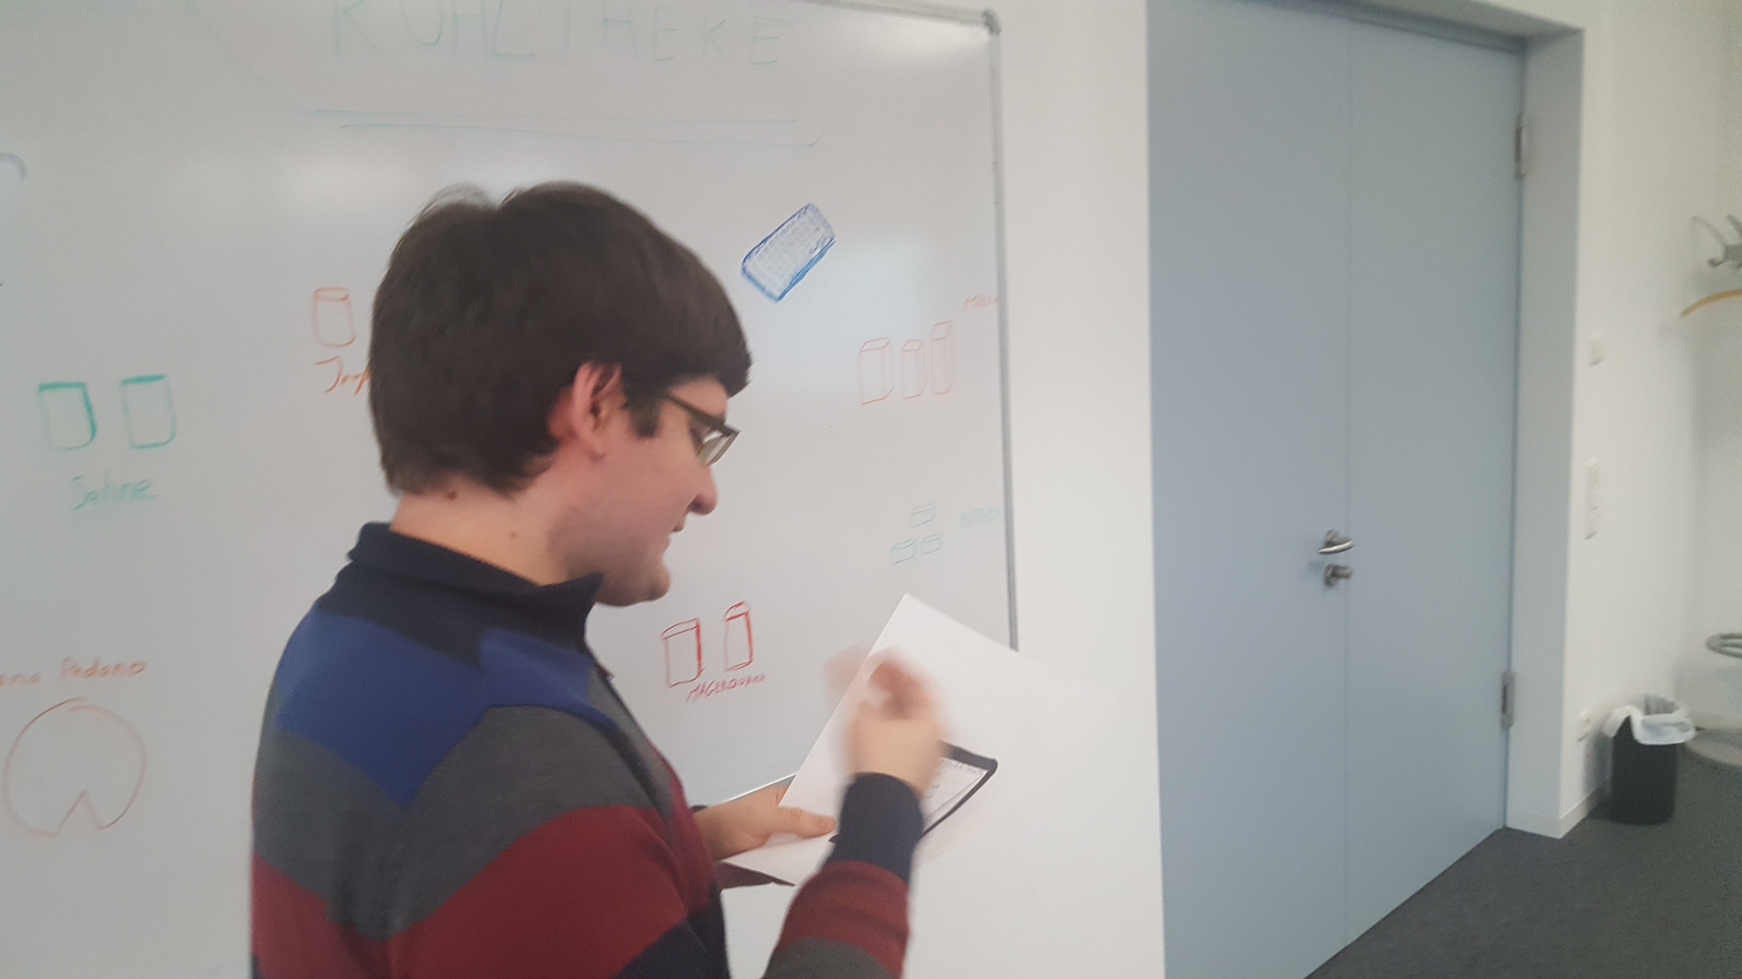
Paper Prototyping
> Studie

Slide 16
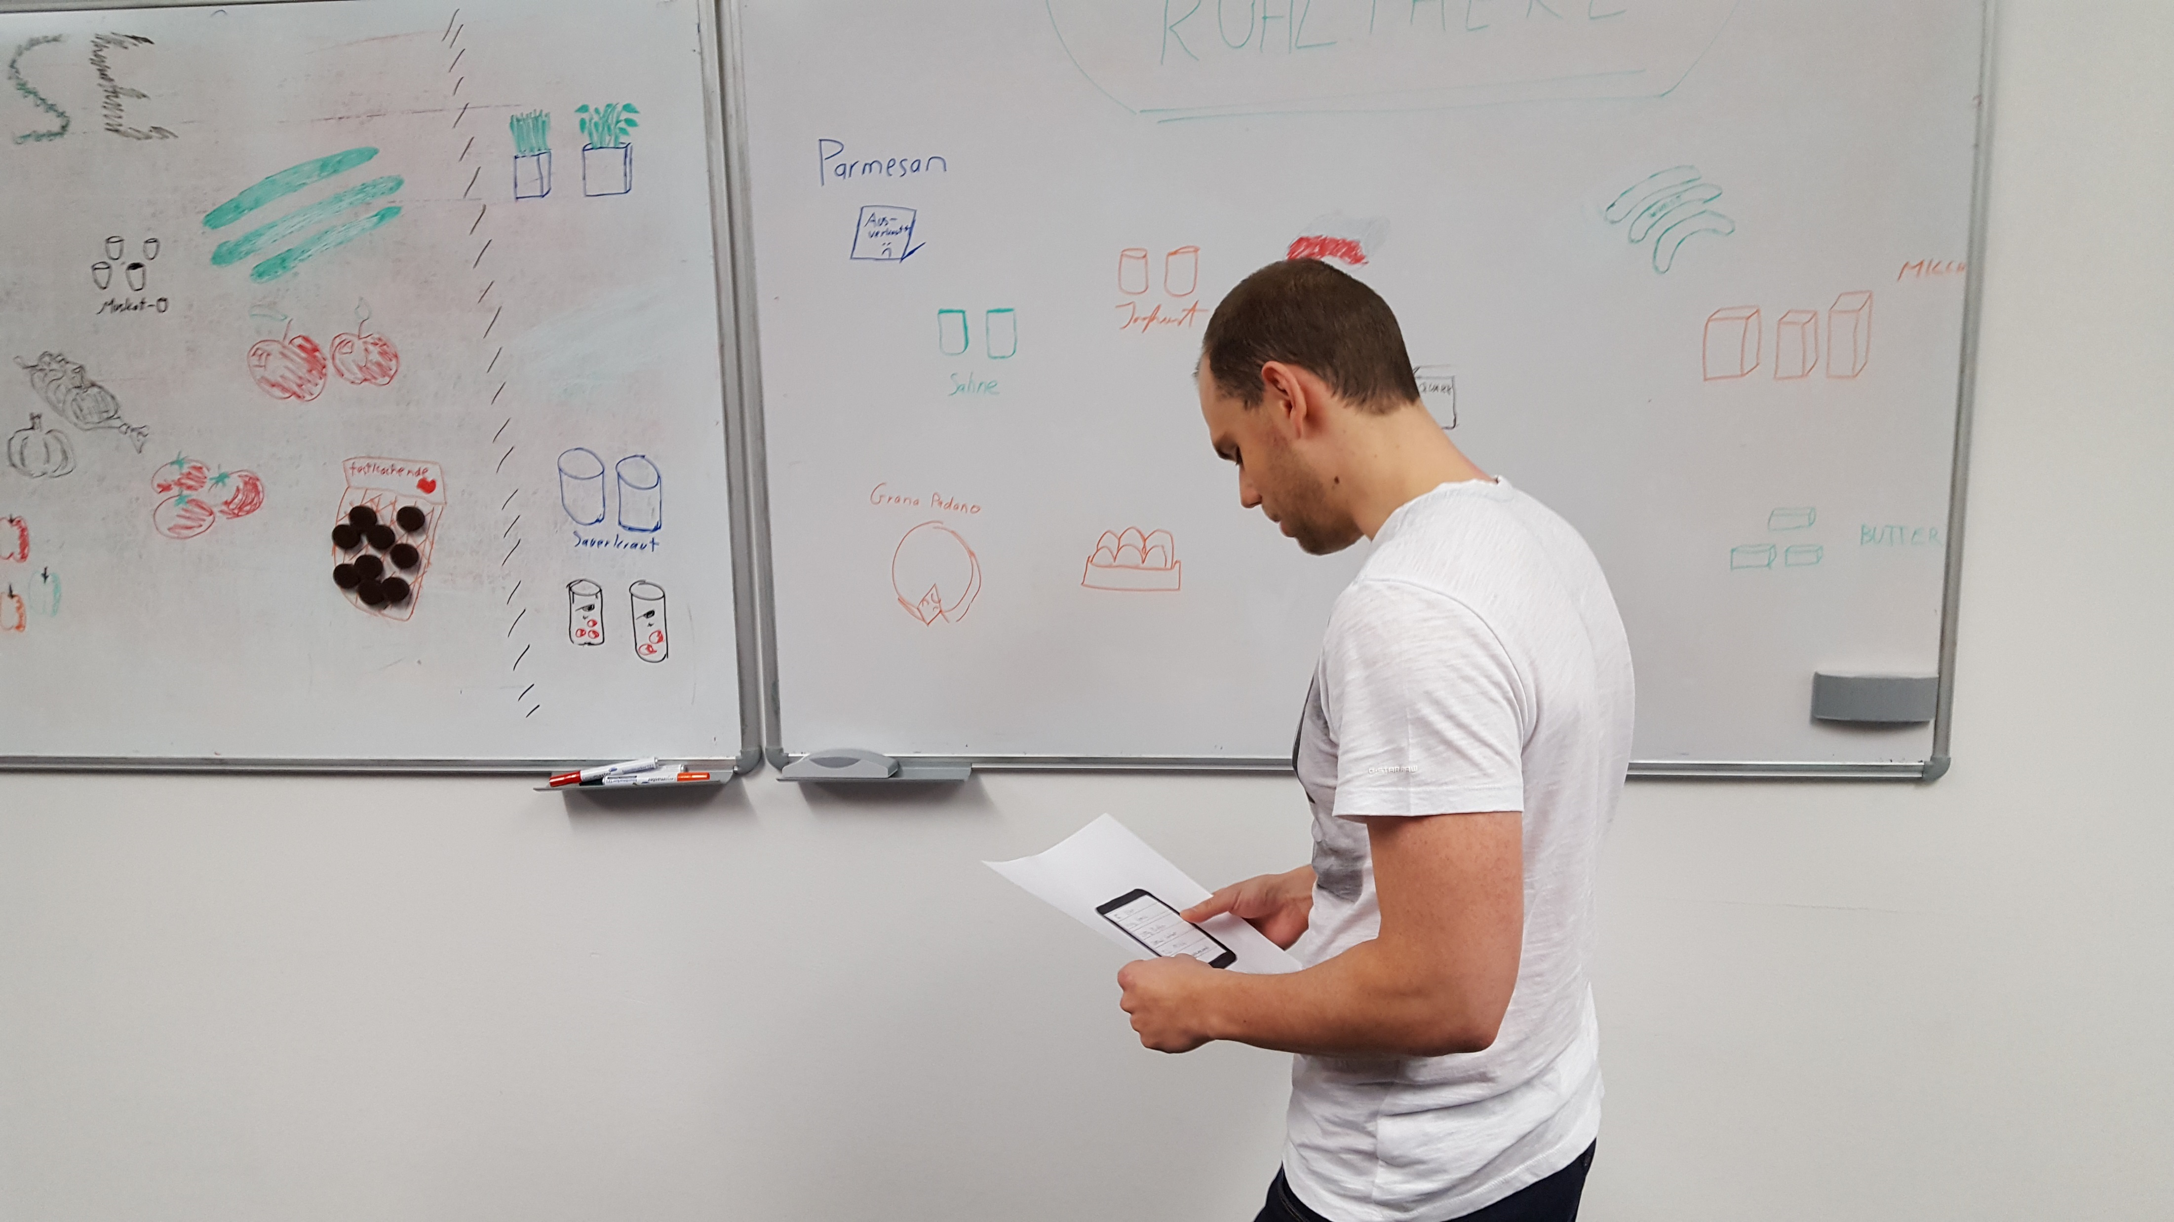
Paper Prototyping
> Studie

Slide 17
Unsorted Lists
A
C
D
E
B
Sorted Lists
A
B
C
D
E
HiFi Prototyping
Sorted and grouped Lists
A1
A2
B1
C1
C2
Carousel Design
A1 B1 C1
A2 B2 C2
A3 C3

Slide 18
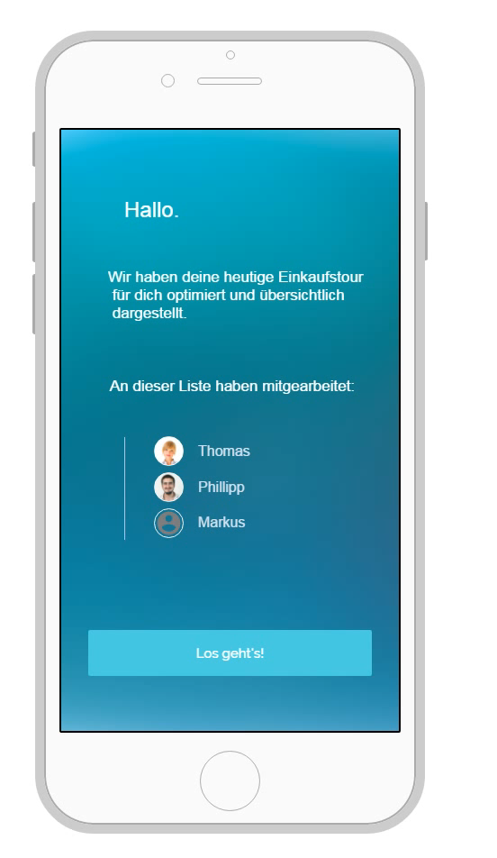
HiFi Prototyping

Slide 19
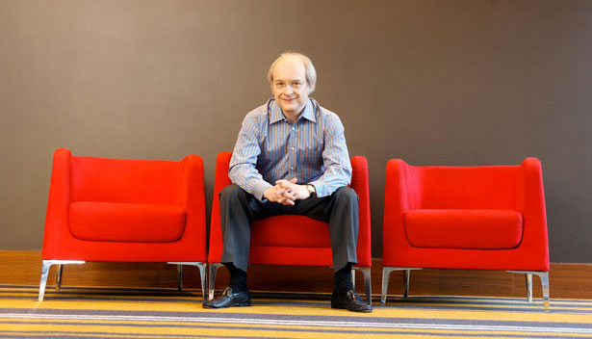
Evaluation

Slide 20
Unsorted Lists
A
C
D
E
B
Sorted Lists
A
B
C
D
E
Second Iteration
HiFi Prototyping
Sorted and grouped Lists
A1
A2
B1
C1
C2
Carousel Design
A1 B1 C1
A2 B2 C2
A3 C3

Slide 21
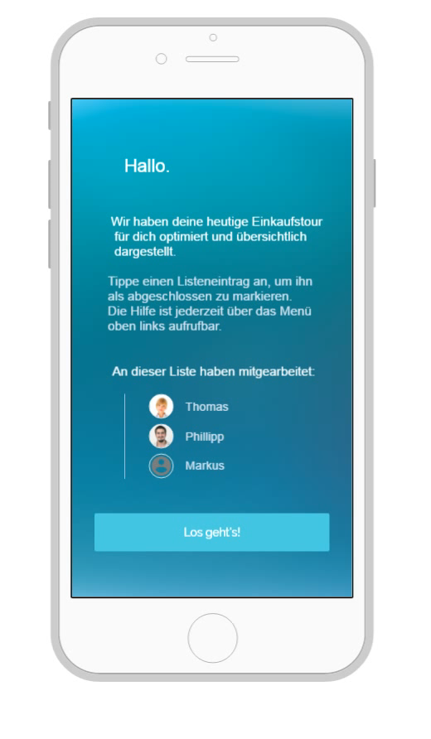
HiFi Prototyping

Slide 22
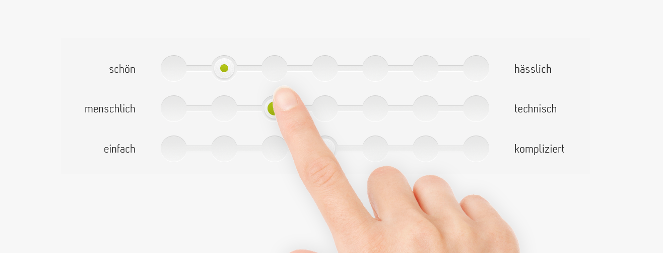
Study Design

Slide 23
alte_webseite<-c(23,43,23,43,22,34,33,24,44)
neue_webseite<-c(15,32,14,23,10,26,27,24,12)
websiteData<-data.frame(alte_webseite, neue_webseite)
# long version
user <- c("vsp1","vsp2","vsp3","vsp4","vsp5","vsp6","vsp7","vsp8","vsp9","vsp1","vsp2","vsp3","vsp4","vsp5","vsp6","vsp7","vsp8","vsp9")
condition<-c("alt","alt","alt","alt","alt","alt","alt","alt","alt","neu","neu","neu","neu","neu","neu","neu","neu","neu")
rating <- c(23,43,23,43,22,34,33,24,44,15,32,14,23,10,26,27,24,12)
websiteDataLong<-data.frame(user, condition, rating)
libido<-c(3,2,1,1,4,5,2,4,2,3,7,4,5,3,6)
dose<-gl(3,5, labels = c("Placebo", "Low Dose", "High Dose"))
viagraData<-data.frame(dose, libido)
Study Evaluation

